Slide 1
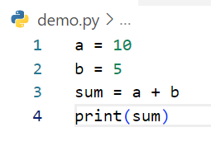
Write step following code below
Step | a | b | sum | output
1 | 10
2 | 10 | 5
3 | 10 | 5 | 15
4 | 10 | 5 | 15 | 15
Example

Slide 2
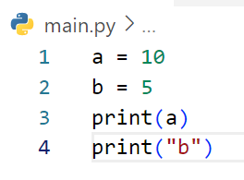
Write step following code below
Step | a | b | output
1 | 10
2 | 10 | 5
3 | 10 | 5 | 10
4 | 10 | 5 | b

Slide 3
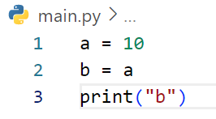
Write step following code below
Step | a | b | output
1 | 10
2 | 10 | a
3 | 10 | a | b

Slide 4
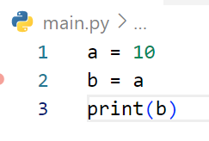
Write step following code below
Step | a | b | output
1 | 10
2 | 10 | a
3 | 10 | a | 10

Slide 5
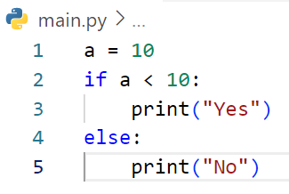
Write step following code below
Step | A | a<10 | output
1 | 10
2 | 10 | False
3 | 10 |  | No

Slide 6
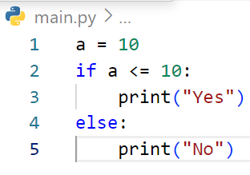
Write step following code below
Step | a | a <= 10 | output
1 | 10
2 | 10 | True
3 | 10 |  | Yes

Slide 7
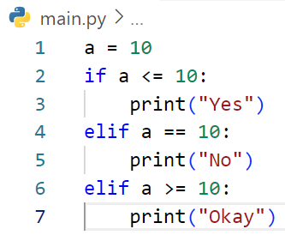
Write step following code below
Step | A | A<=10 | output
1 | 10
2 | 10 | True
3 | 10 |  | Yes

Slide 8
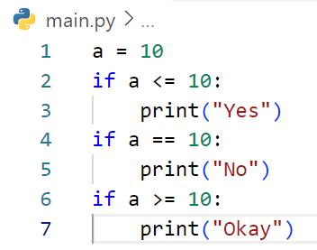
Write step following code below
Step | a | a<=10 | a==10 | a>=10 | output
1 | 10
2 | 10 | True
3 | 10 |  |  |  | Yes
4 | 10 |  | True
5 | 10 |  |  |  | No
6 | 10 |  |  | True
7 | 10 |  |  |  | Okay

Slide 9
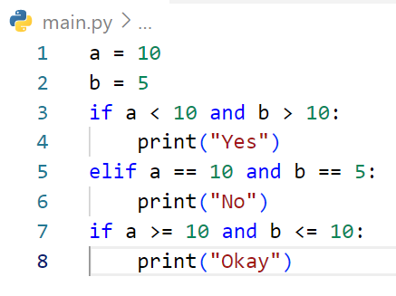
Write step following code below
Step | a | b | A<10 and b>10 | a==10 and b==5 | A ==10 and b<=10 | Output
1 | 10
2 | 10 | 5
3 | 10 | 5 | False
4 | 10 | 5 |  | True
5 | 10 | 5 |  |  |  | No
6 | 10 | 5 |  |  | True
7 | 10 | 5 |  |  |  | Okay

Slide 10
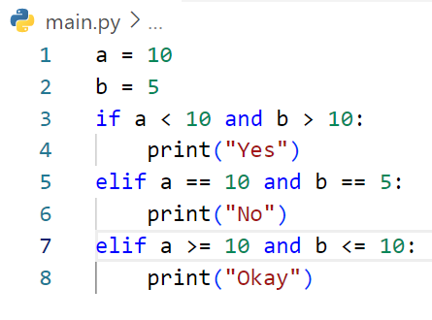
Write step following code below
Step | a | b | a<10 and b>10 | A==10 and b==5 | output
1 | 10
2 | 10 | 5
3 | 10 | 5 | False
4 | 10 | 5 |  | True
5 | 10 | 5 |  |  | No

Slide 11
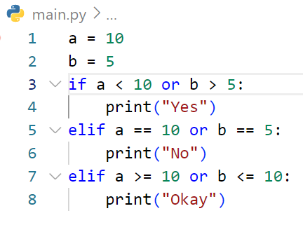
Write step following code below
Step | a | b | a<10 or b>5 | a==10 or b==5 | output
1 | 10
2 | 10 | 5
3 | 10 | 5 | False
4 | 10 | 5 |  | True
5 | 10 | 5 |  |  | No
6 | 10 | 5

Slide 12
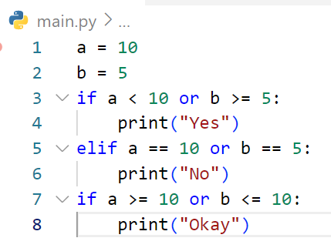
Write step following code below
Step | A | b | a<10 or b>=5 | A>=10 or b<=10 | output
1 | 10
2 | 10 | 5
3 | 10 | 5 | True
4 | 10 | 5 |  |  | Yes
5 | 10 | 5 |  | True
6 | 10 | 5 |  |  | Okay

Slide 13
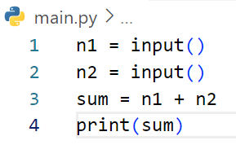
Write step following code below
Step | n1 | n2 | sum | output
1 | 3
2 | 3 | 5
3 | 3 | 5 | 35
4 | 3 | 5 | 35 | 35
# If user enter first : 3 and second 5

Slide 14
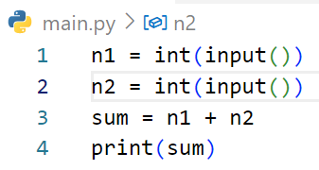
Write step following code below
Step | n1 | n2 | sum | output
1 | 3
2 | 3 | 5
3 | 3 | 5 | 8
4 | 3 | 5 | 8 | 8
# If user enter first : 3 and second 5

Slide 15
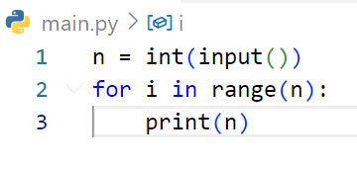
Write step following code below
Step | n | i | output
1 | 3
2 | 3 | 0
3 | 3 | 0 | 3
4 | 3 | 1
5 | 3 | 1 | 3
6 | 3 | 2
7 | 3 | 2 | 3
# If user enter : 3

Slide 16
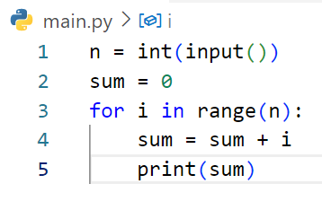
Write step following code below
Step | i | n | sum | output
1 |  | 3
2 |  | 3 | 0
3 | 0 | 3 | 0
4 | 0 | 3 | 0
5 | 0 | 3 | 0 | 0
6 | 1 | 3 | 0
7 | 1 | 3 | 1
8 | 1 | 3 | 1 | 1
9 | 2 | 3 | 1
10 | 2 | 3 | 3
11 | 2 | 3 | 3 | 3
# If user enter : 3

Slide 17
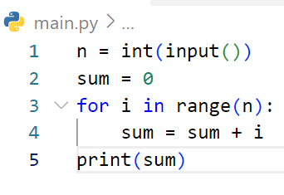
Write step following code below
Step | i | n | sum | output
1 |  | 2
2 |  | 2 | 0
3 | 0 | 2 | 0
4 | 0 | 2 | 0
5 | 1 | 2 | 0
6 | 1 | 2 | 1
7 | 1 | 2 | 1 | 1
# If user enter : 2

Slide 18
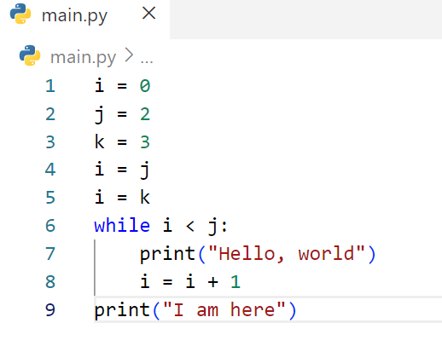
Write step following code below
Step | i | j | k | i<j | output
1 | 0
2 | 0 | 2
3 | 0 | 2 | 3
4 | 2 | 2 | 3
5 | 3 | 2 | 3
6 | 3 | 2 | 3 | False
7 | 3 | 2 | 3 |  | I am here

Slide 19
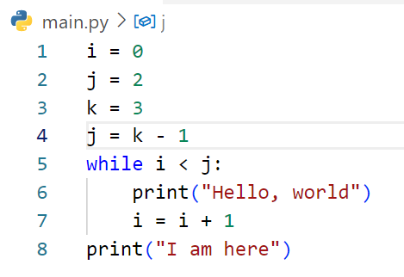
Write step following code below
Step | i | j | k | i<j | output
1 | 0
2 | 0 | 2
3 | 0 | 2 | 3
4 | 0 | 2 | 3
5 | 0 | 2 | 3 | True
6 | 0 | 2 | 3 |  | Hello, world
7 | 1 | 2 | 3
8 | 1 | 2 | 3 | True
9 | 1 | 2 | 3 |  | Hello, world
10 | 2 | 2 | 3
11 | 2 | 2 | 3 | False
12 | 2 | 2 | 3 |  | I am here

Slide 20
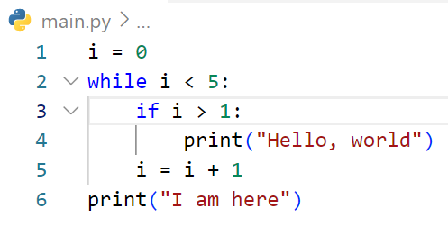
Step | i | i<5 | i>1 | output
1 | 0
2 | 0 | True
3 | 0 |  | False
4 | 1 | True
5 | 1 |  | False
6 | 2 | True
7 | 2 |  | True
8 | 2 |  |  | Hello, world
9 | 3
10 | 3 | True
11 | 3 |  | True
12 | 3 |  |  | Hello, world
13 | 4
14 | 4 | True
15 | 4 |  | True
16 | 4 |  |  | Hello, world
17 | 5
18 | 5 | False
19 | 5 |  |  | I am here
Write step following code below

Slide 21
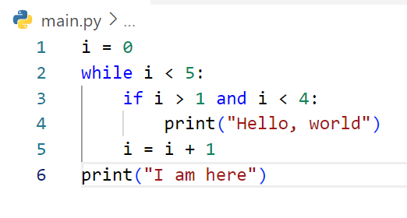
Step | i | i<5 | i>1 and i<4 | output
1 | 0
2 | 0 | True
3 | 0 |  | False
4 | 1
5 | 1 | True
6 | 1 |  | False
7 | 2
8 | 2 | True
9 | 2 |  | True
10 | 2 |  |  | Hello, world
11 | 3
12 | 3 | True
13 | 3 |  | True
14 | 3 |  |  | Hello, world
15 | 4
16 | 4 | True
17 | 4 |  | False
18 | 5
19 | 5 | False
20 | 5 |  |  | I am here
Write step following code below

Slide 22
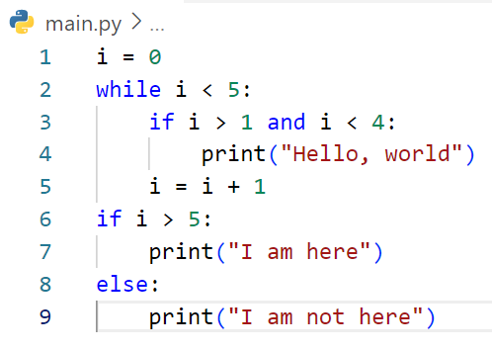
Step | i | i<5 | i>1 and i <4 | i>5 | output
1 | 0
2 | 0 | True
3 | 0 |  | False
4 | 1
5 | 1 | True
6 | 1 |  | False
7 | 2
8 | 2 | True
9 | 2 |  | True
10 | 2 |  |  |  | Hello, world
11 | 3
12 | 3 | True
13 | 3 |  | True
14 | 3 |  |  |  | Hello, world
15 | 4 | True
16 | 4 |  | False
17 | 5
18 | 5 | False
19 | 5 |  |  | False
20 | 5 |  |  |  | I am not here
Write step following code below

Slide 23
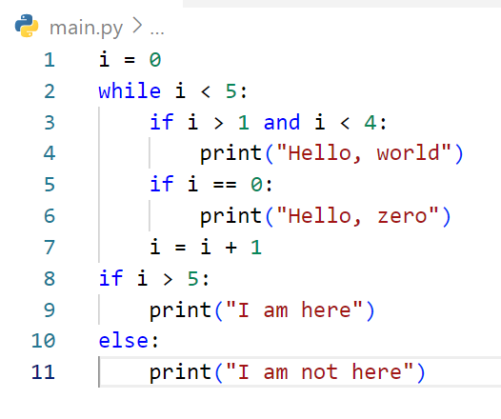
Step | i | i<5 | i>1and i<4 | i==0 | i>5 | output
1 | 0
2 | 0 | True
3 | 0 | True | False
4 | 0 | True |  | True
5 | 0 | True |  |  |  | Hello, zero
6 | 1
7 | 1 | True
8 | 1 | True | False
9 | 1 | True |  | False
10 | 2
11 | 2 | True
12 | 2 | Ture |  | True
13 | 2 | True |  | True |  | Hello, world
14 | 2 | True |  | False
15 | 3
16 | 3 | True
17 | 3 | True | True
18 | 3 | True | True |  |  | Hello, world
19 | 3 | True |  | False
20 | 4
21 | 4 | True
22 | 4 | True | False
23 | 4 | True | False
24 | 5
25 | 5 | False
26 | 5 |  |  |  | False
27 | 5 |  |  |  |  | I am not here
Write step following code below

Slide 24
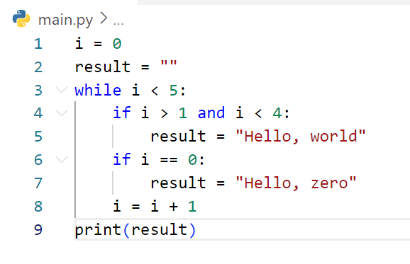
Step | i | result | i<5 | I >4 and i<4 | I == 0 | output
1 | 0
2 | 0 | ““
3 | 0 | “” | True
4 | 0 | “” |  | False
5 | 0 | “” |  |  | True
6 | 0 | Hello, zero
7 | 1 | Helllo, zero
8 | 1 | Hello, zero | True
9 | 1 | Hello, zero |  | False
10 | 1 | Hello, zero |  |  | False
11 | 2 | Hello, zero
12 | 2 | Helo, zero | True
13 | 2 | Hello, zero |  | True
14 | 2 | Hello, world
15 | 2 | Hello, world | True |  | False
16 | 3 | Hello, world
17 | 3 | Hello, world | True
18 | 3 | Hello, world |  | True
19 | 3 | Hello, world
20 | 3 | Hello, wold |  |  | False
21 | 4 | Hello, world
22 | 4 | Hello, world | True
23 | 4 | Hello, world |  | False
24 | 4 | Hello, world |  |  | False
25 | 5 | Hello, world
26 | 5 | Hello, world | False
27 | 5 | Hello, world |  |  |  | Hello, world
Write step following code below

Slide 25
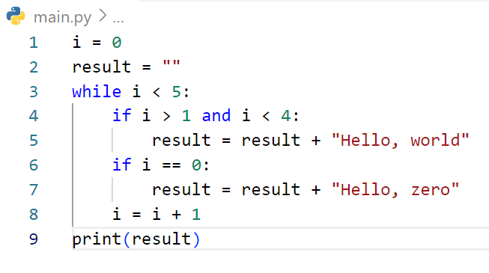
Step | i | result | i<5 | I >4 and i<4 | I == 0 | output
1 | 0
2 | 0 | ““
3 | 0 | “” | True
4 | 0 | “” |  | False
5 | 0 | “” |  |  | True
6 | 0 | Hello, zero
7 | 1 | Helllo, zero
8 | 1 | Hello, zero | True
9 | 1 | Hello, zero |  | False
10 | 1 | Hello, zero |  |  | False
11 | 2 | Hello, zero
12 | 2 | Helo, zero | True
13 | 2 | Hello, zero |  | True
14 | 2 | Hello, zero Hello, world
15 | 2 | Hello, zero Hello, world | True |  | False
16 | 3 | Hello, zero Hello, world
17 | 3 | Hello, zero Hello, world | True
18 | 3 | Hello, zero Hello, world |  | True
19 | 3 | Hello, zero Hello, world Hello, wold
20 | 3 | Hello, zero Hello, world Hello, wold |  |  | False
21 | 4 | Hello, zero Hello, world Hello, wold
22 | 4 | Hello, zero Hello, world Hello, wold | True
23 | 4 | Hello, zero Hello, world Hello, wold |  | False
24 | 4 | Hello, zero Hello, world Hello, wold |  |  | False
25 | 5 | Hello, zero Hello, world Hello, wold
26 | 5 | Hello, zero Hello, world Hello, wold | False
27 | 5 | Hello, zero Hello, world Hello, wold |  |  |  | Hello, zero Hello, world Hello, world
Write step following code below

Slide 26
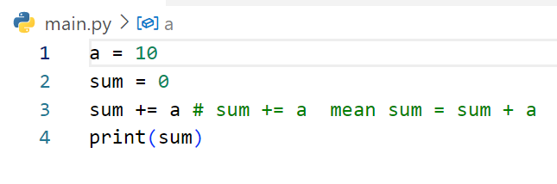
Write step following code below
Step | a | sum | output
1 | 10
2 | 10 | 0
3 | 10 | 10
4 | 10 | 10 | 10

Slide 27
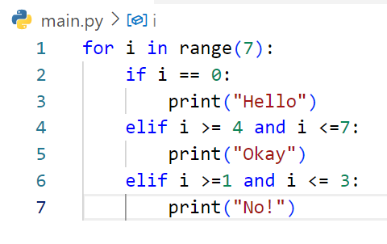
Step | i | I == 0 | I >= 4 and i <=7 | i>=1 and i<=3 | output
1 | 0
2 | 0 | True
3 | 0 |  |  |  | Hello
4 | 1 | False
5 | 1 |  | False
6 | 1 |  |  | True
7 | 1 |  |  |  | No
8 | 2 | False
9 | 2 |  | False
10 | 2 |  |  | True
11 | 2 |  |  |  | No
12 | 3 | False
13 | 3 |  | False
14 | 3 |  |  | True
15 | 3 |  |  |  | No
16 | 4 | False
17 | 4 |  | True
18 | 4 |  |  |  | Okay
19 | 5 | False
20 | 5 |  | True
21 | 5 |  |  |  | Okay
22 | 6 | Flase
23 | 6 |  | True
24 | 6 |  |  |  | Okay
Write step following code below

Slide 28
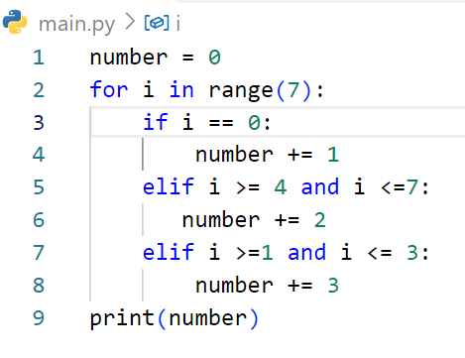
Step | i | number | i == 0 | I >=4 and i<=7 | I >=1 and i<=3 | output
1 |  | 0
2 | 0 | 0
3 | 0 | 0 | True
4 | 0 | 1
5 | 1 | 1 | False
6 | 1 | 1 |  | False
7 | 1 | 1 |  |  | True
8 | 1 | 4
9 | 2 | 4 | Fasle
10 | 2 | 4 |  | False
11 | 2 | 4 |  |  | True
12 | 2 | 7
13 | 3 | 7 | False
14 | 3 | 7 |  | False
15 | 3 | 7 |  |  | True
16 | 3 | 10
17 | 4 | 10 | False
18 | 4 | 10 |  | True
19 | 4 | 12
20 | 5 | 12 | False
21 | 5 | 12 |  | True
22 | 5 | 14
23 | 6 | 14 | False
24 | 6 | 14 |  | True
25 | 6 | 16
26 | 6 | 16 |  |  |  | 16
Write step following code below

